Slide 1
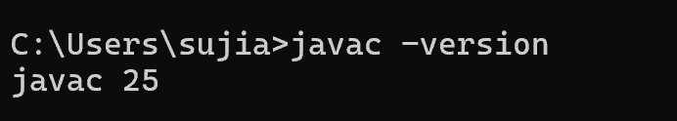
JMeter Installation:
Java : Java Downloads | Oracle (javac -version)
JMeter : Apache JMeter - Download Apache Jmeter
JMeter Plugins: Install :: JMeter-Plugins.org

Slide 2
JMeter Launching in Windows:
GUI Mode: Jmeter.bat or ApacheJMeter.jar file (Not Recommended)
Non-GUI Mode
Proxy Mode: If you are testing/recording from behind a firewall/proxy server, you need to launch the JMeter with the firewall/proxy server hostname, port number, Username and password
e.g:
jmeter –E https –H my.proxy.server –P 8000 –u Username –a password –N localhost
jmeter –H 198.168.10.2 –P 8000 –u Username –a password –N localhost

Slide 3
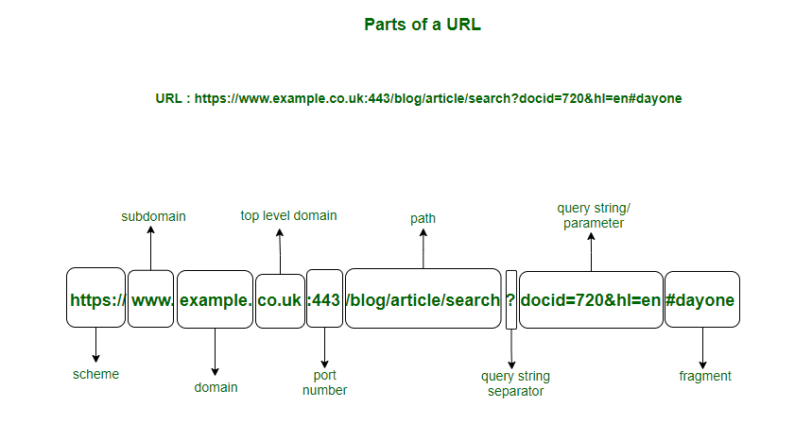

Slide 4
Important Properties before Recording:
Undo and Redo Setting: undo.history.size
Jmeter certificate’s expire time : proxy.cert.validity
Increasing the view results tree’s line limitation : view.results.tree.max_results=0

Slide 5
Recording Steps:
  Create the Recording Template
  Enable the HTTPS Test script recorder
  Inside HTTPS Test Script recorder -> view results tree browse the file path to capture the recording (.xml)
  Certificate Generation
  Configure the certificate in the browser
  Proxy settings (If you’re using the browser, this step can skip)
  Record the script
  After completion of script disable the HTTPS Test script recorder

Slide 6
Enhancement of Script:
Take a back up copy
Remove irrelevant URLS and Embedded resources
If any misplaced/misarranged requests are found, arrange /put them in their respective transaction controller.
Add numbers sequentially to all requests for transactions.
Put check mark in Generate Parent sample option for each transaction controller
Add HTTP Request defaulter at Test plan level
Add HTTP cookie manager and Cache manager inside thread group and put check mark in “Clear Cookies Each Iteration”
Add the Debug sampler at thread group level
Find the Dynamic Values and do the Co Relation and parameterization.
Use Response assertions
Add the timers (Think Time)
Apply Error handling if required
Test script stabilization.

Slide 7
Dynamic Values: Dynamic values are server-generated values that change every time for the same transaction and different users.
Co-Relation:
Correlation is the process of capturing dynamic values from server responses and reusing them in subsequent requests.
Example of Conventional Dynamic Values:
  Session ID
  CSRF Token
  Bearer Token (OAuth 2.0)
  ViewState
  Nonce
  SAML Value
Examples of Business / Non-Conventional Dynamic Values
  Customer ID
  Order Number
  Bill Number
  PNR Number
  Transaction ID
Other Dynamic Data
  Dropdown values
  Multiple selection options
  Records count per page
Dynamic value based on time:
  Unix / Epoch time

Slide 8
Where Dynamic Value will occur:
  Request URL
  Request Header
  Request Body
Availability of dynamic Value:
  Response Body
  Response Header
How to identify Dynamic Values:
Take 2 different username and password (If you don’t have multiple users then use same user) and record the same flow 2 times by changing the user inputs as well, and compare the both scripts for changing data or values.
Correlation Steps
  Identify dynamic value.
  Write and test your pattern(Regular expression/Boundaries) and find the occurrence of the value.
  Capture using Post-Processor
  Store in variable
  Use variable (cntrl + F to replace the variable (${variable}) with value) in next request
Correlation Tools in JMeter:
  Regular Expression Extractor
  Boundary Extractor
  JSON Extractor
  XPath Extractor
  CSS Selector Extractor
Common Correlation Issues:
  Wrong boundaries
  Scope issues
  Missing variable usage

Slide 9
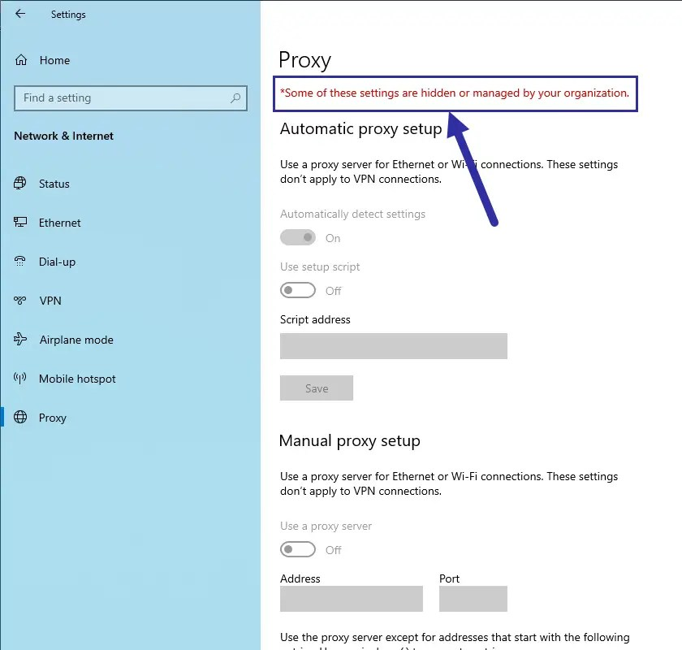
Not able to set the proxy
“<path of browser>” --disable-web-security --allow-file-access-from-files --proxy-server=“http://127.0.0.1:8888” --ignore-certificate-errors --user-data-dir=“C:/Edge Session”

Slide 10
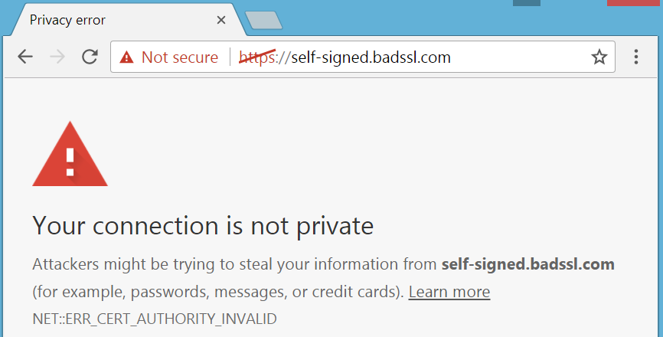

Slide 11
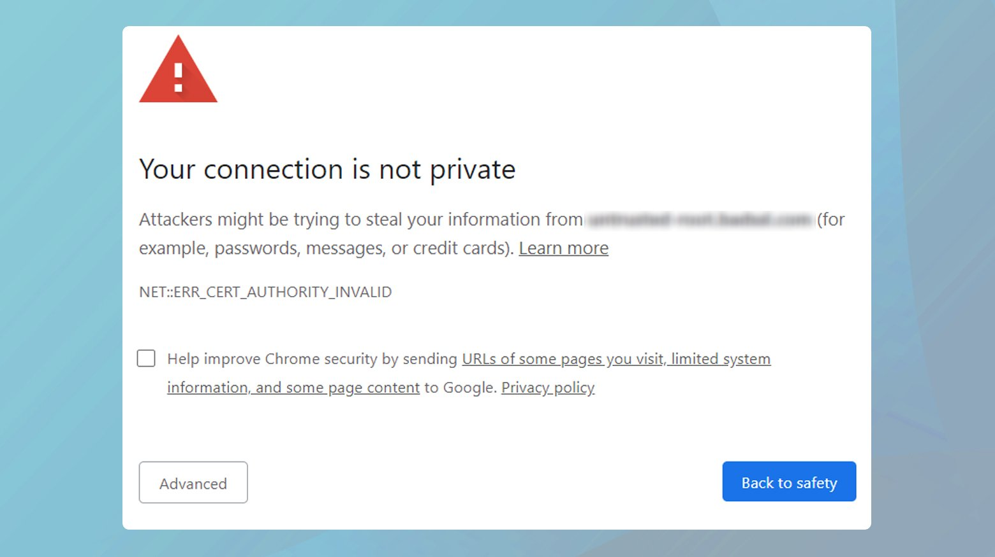

Slide 12
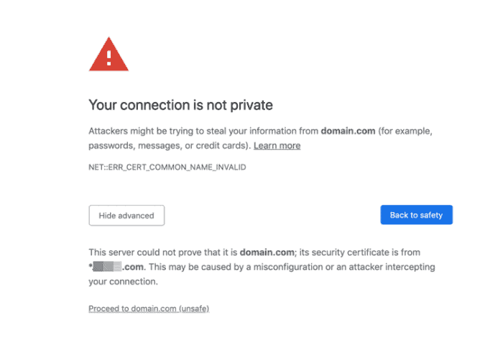

Slide 13
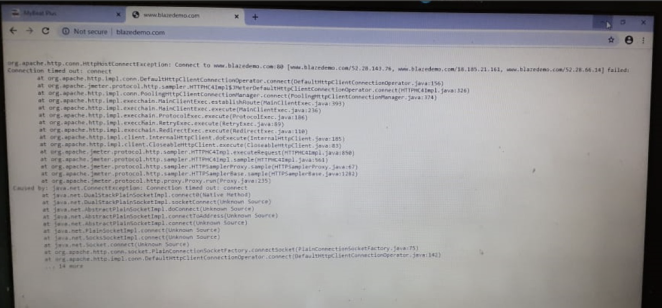

Slide 14
Important Plugins:
Dummy sampler
Parallel controller
Custom thread group
Merge results
Random CSV data set config
Custom JMeter functions

